Slide 1



Slide 2
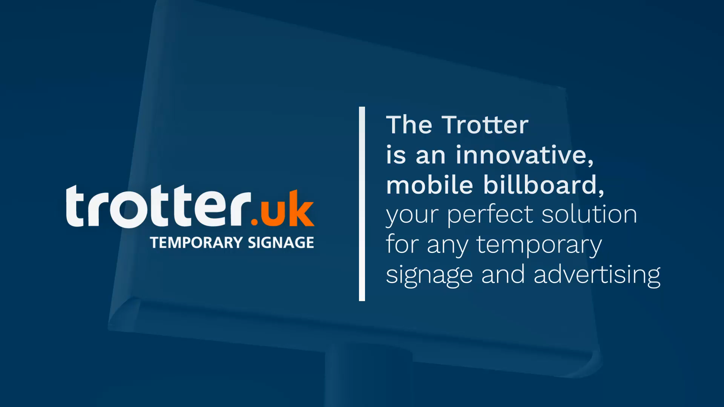

Slide 3
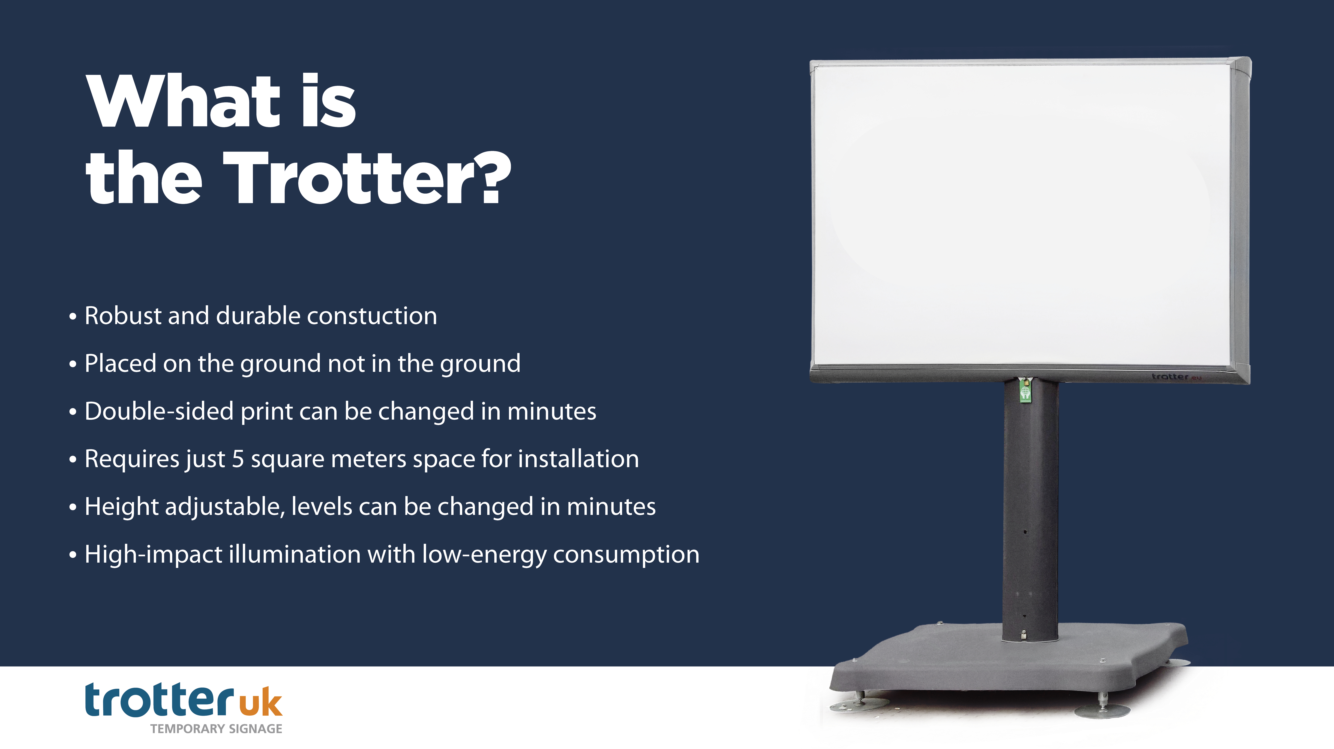

Slide 4
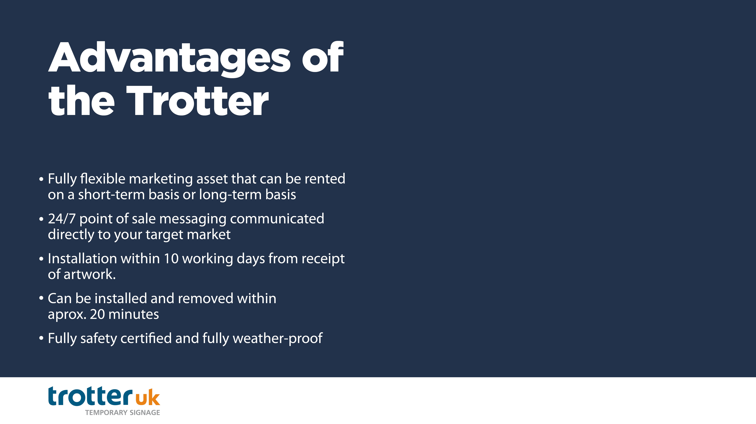
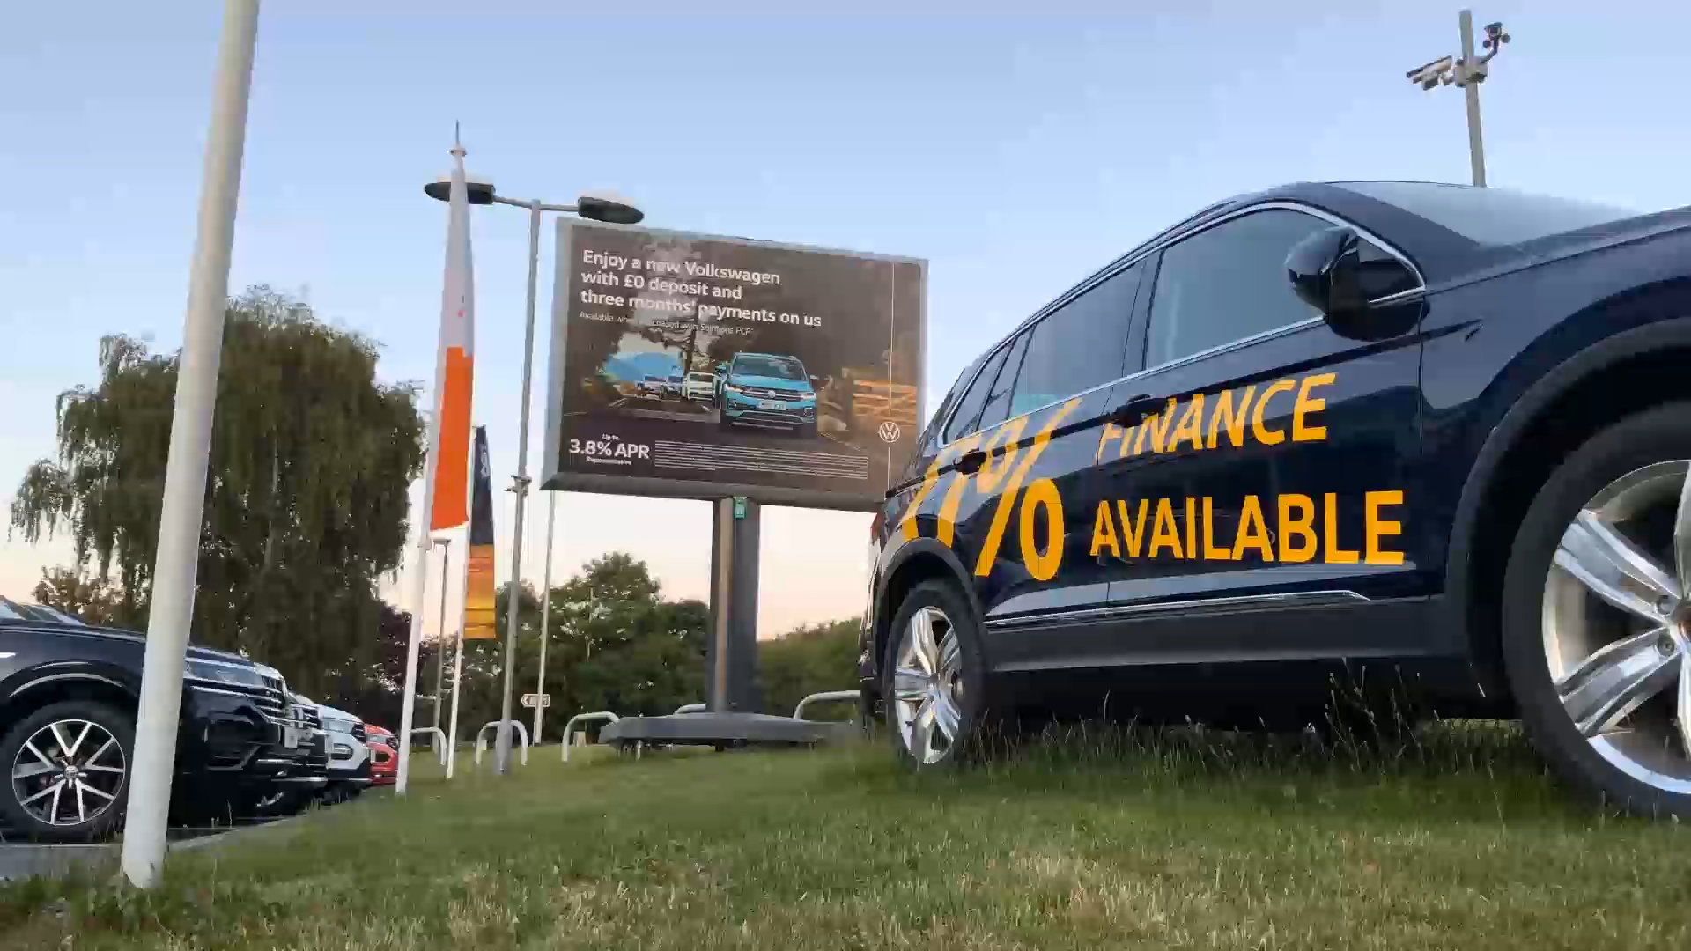
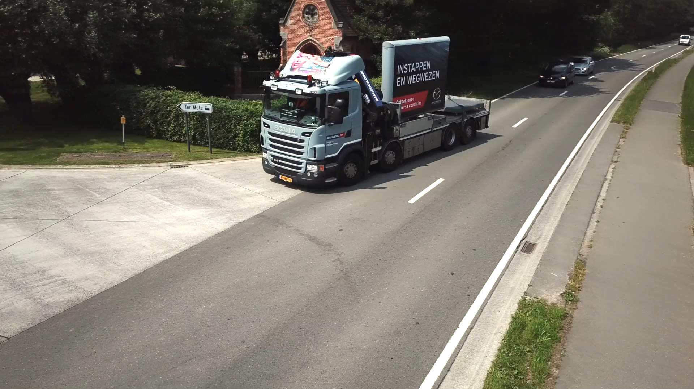

Slide 5

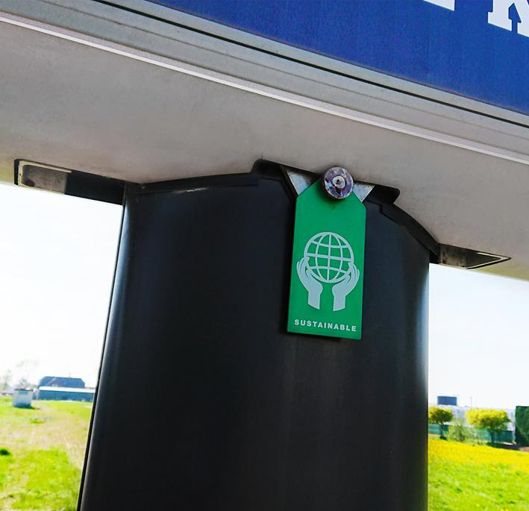

Slide 6
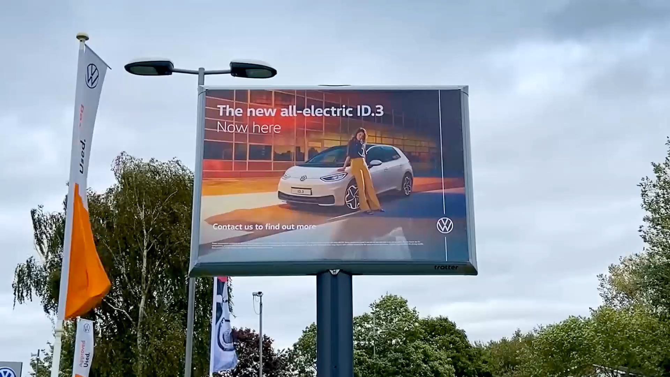

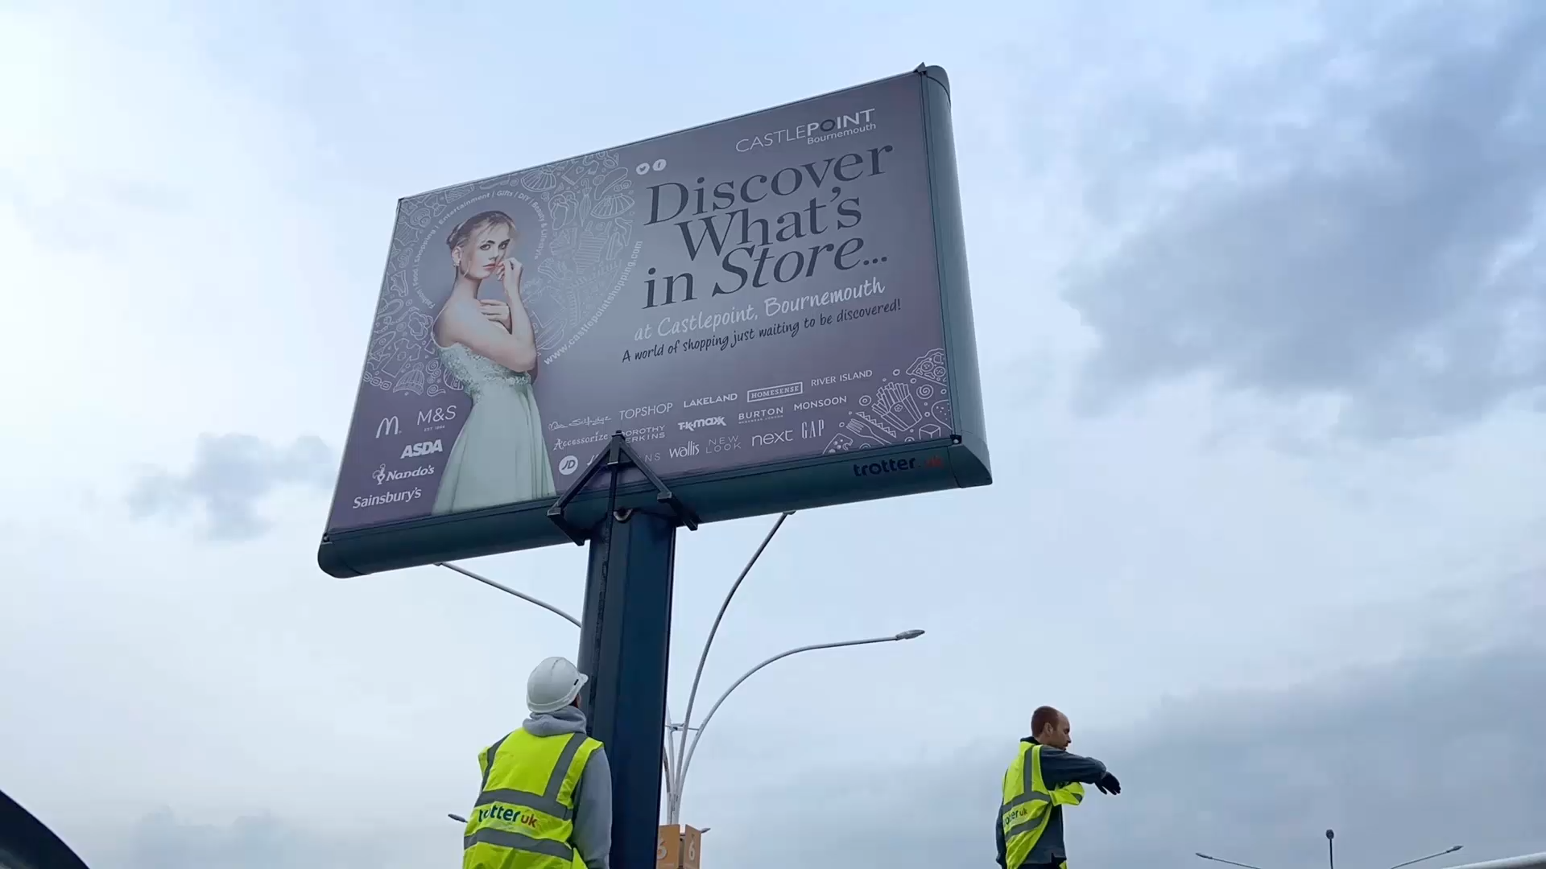
^{Perfect for Automotive}
^{Perfect for Retail}

Slide 7
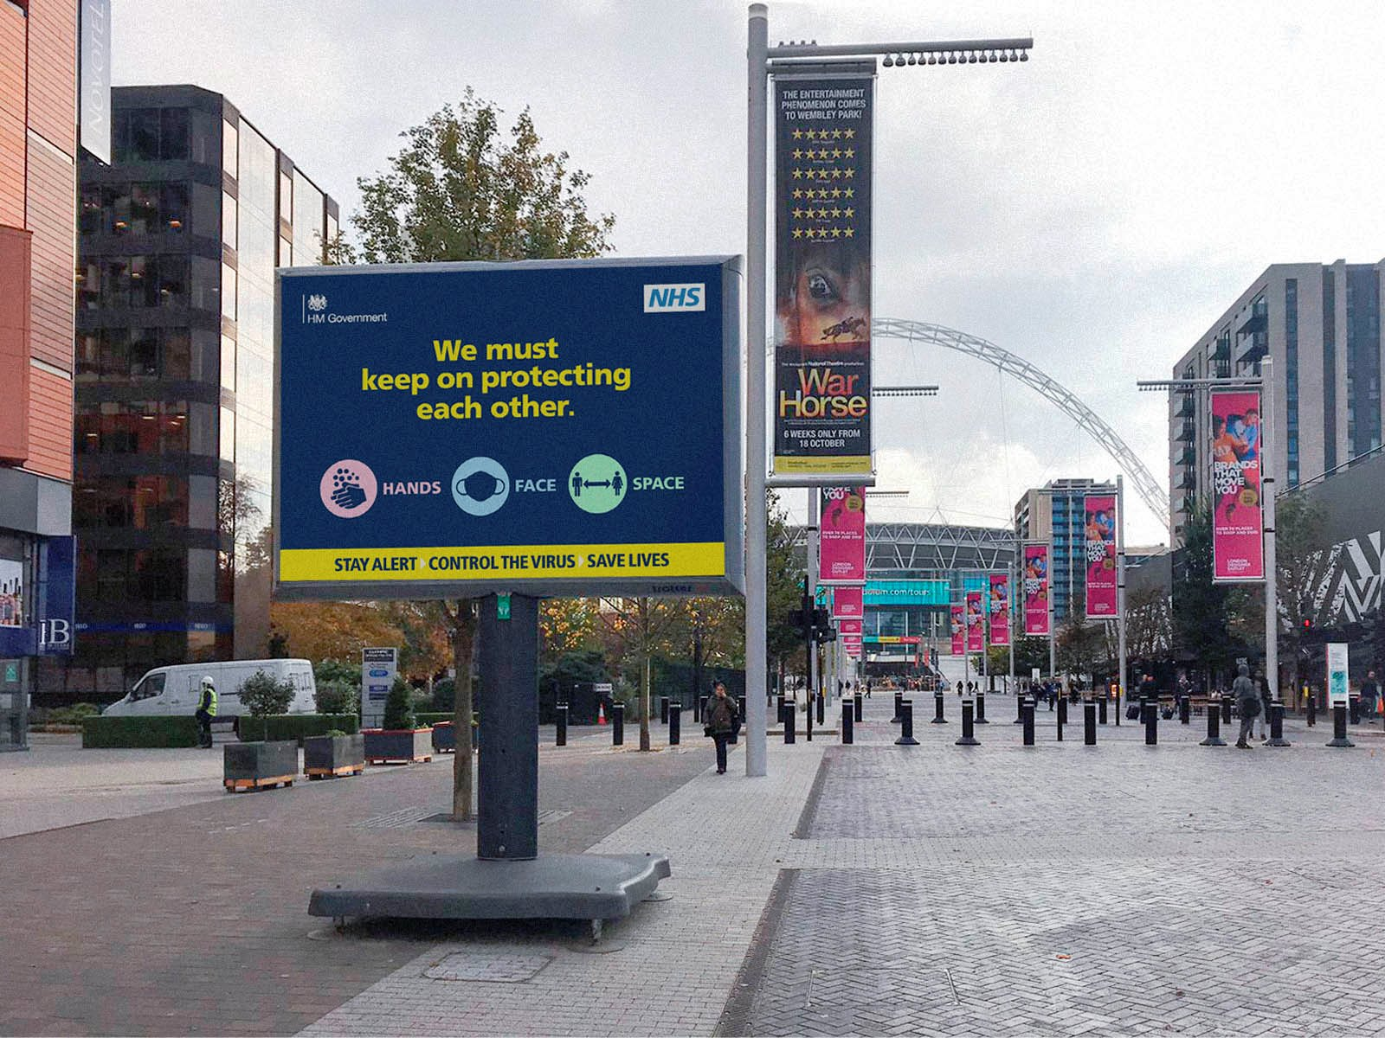
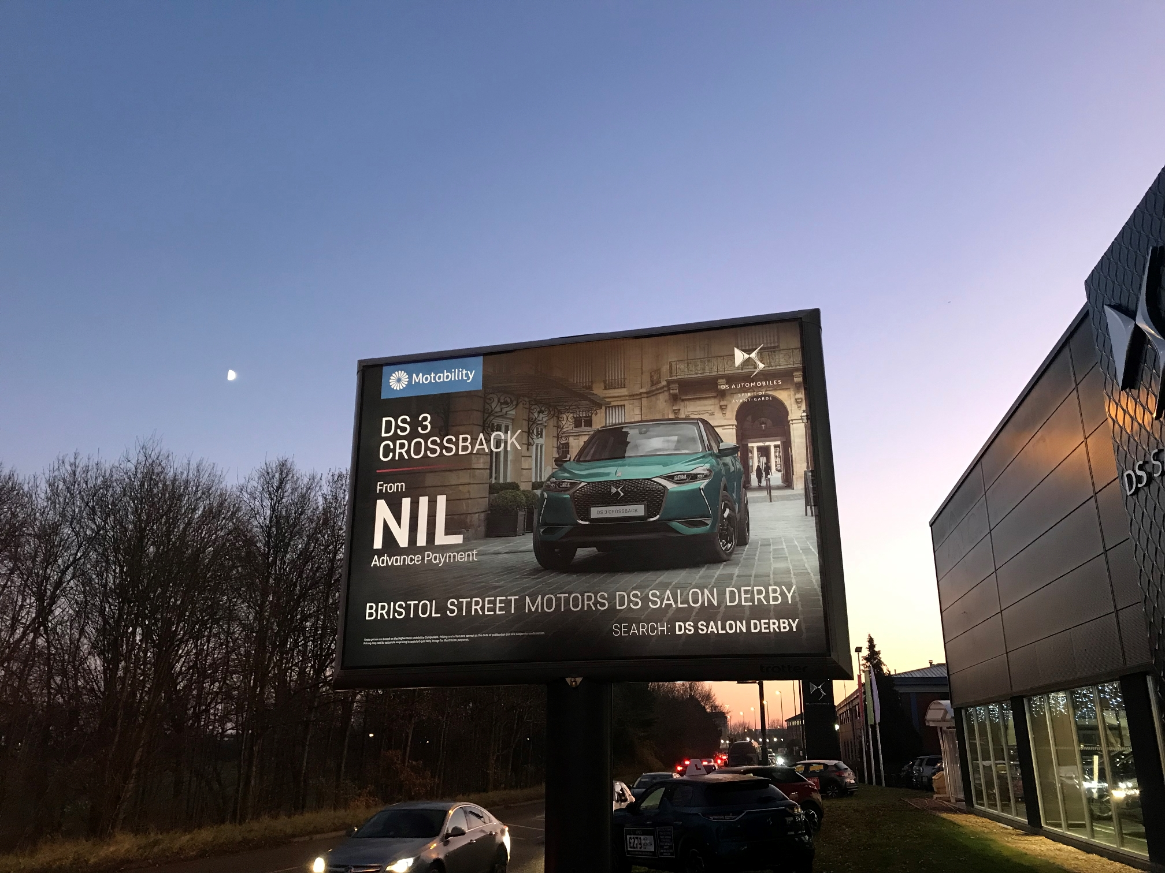
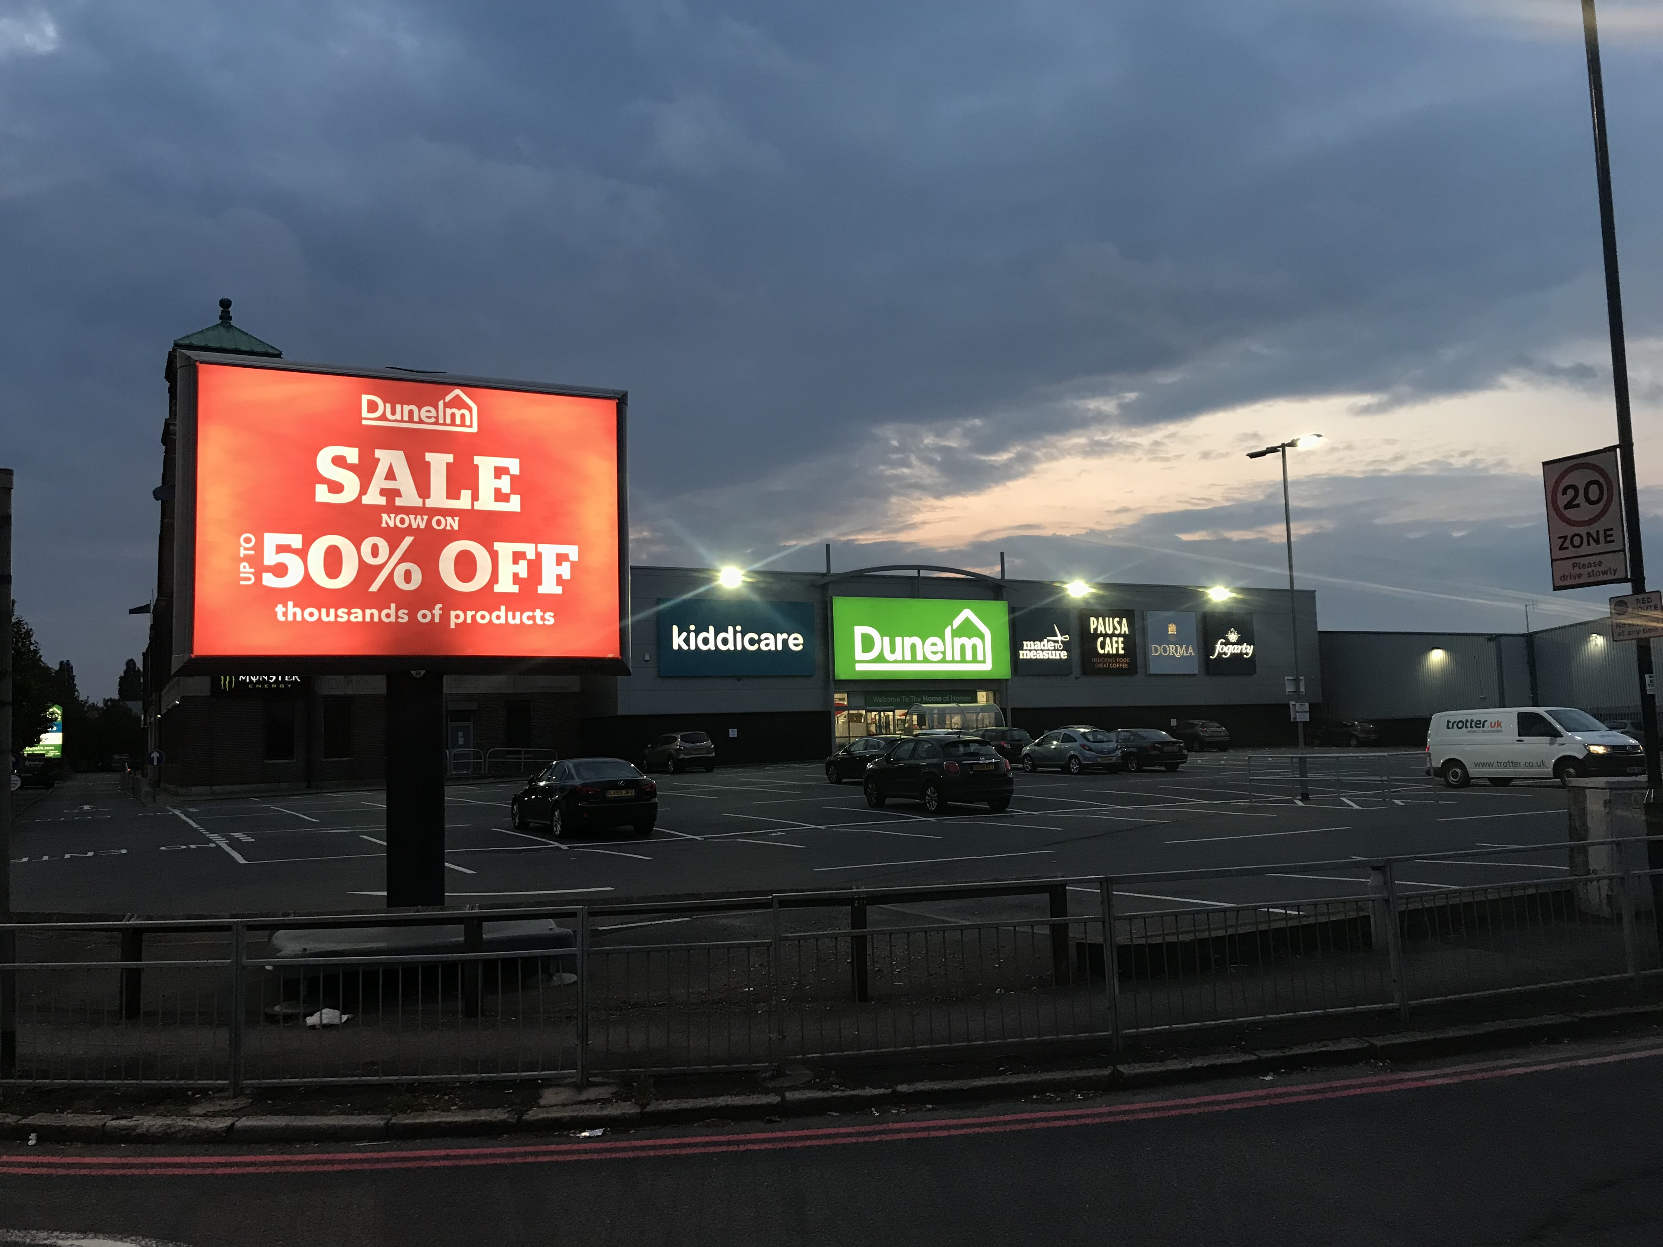
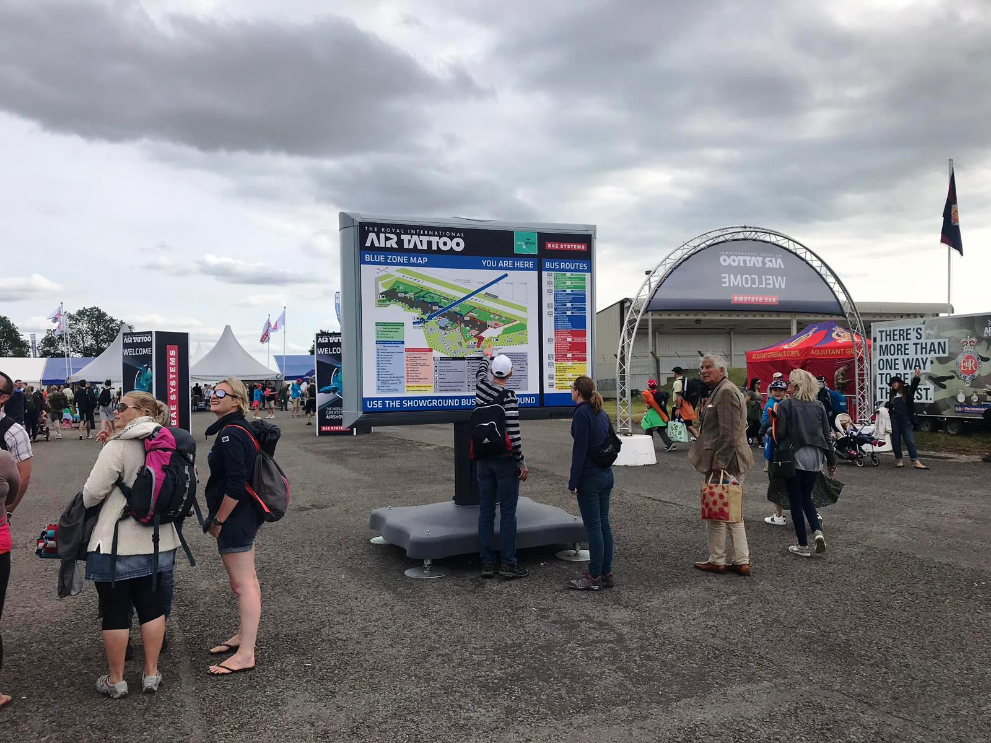

Slide 8
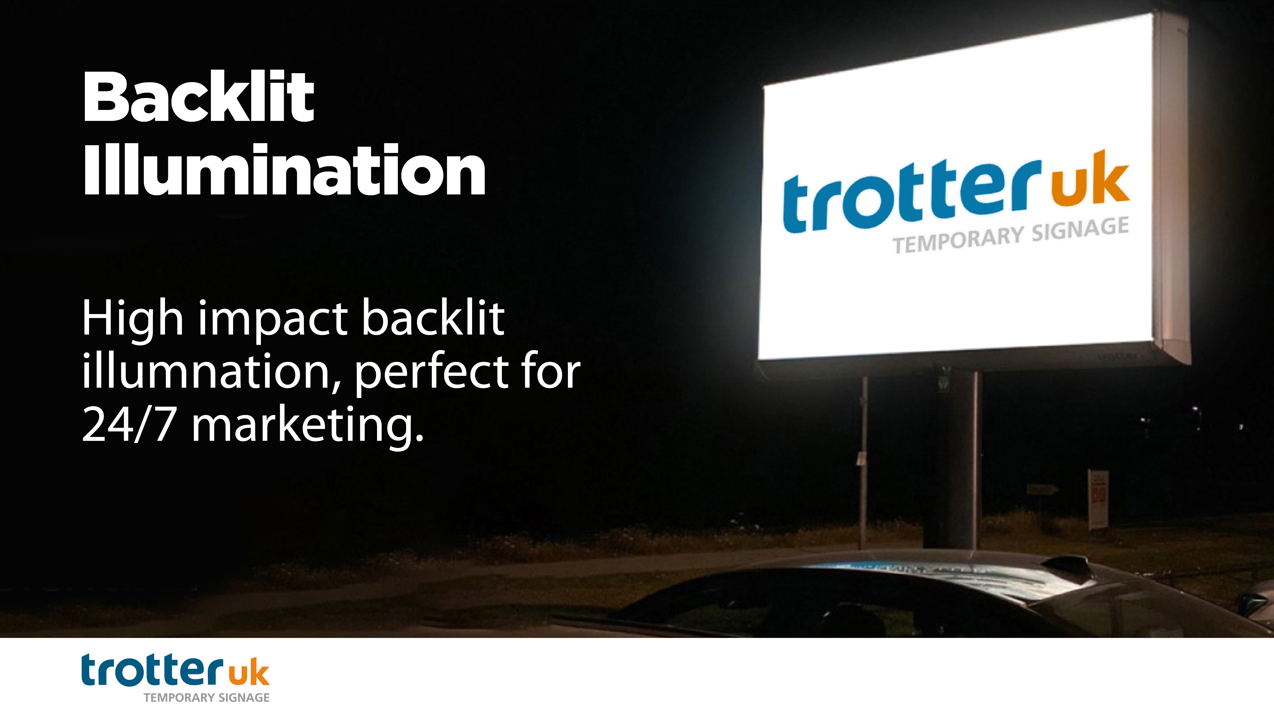

Slide 9
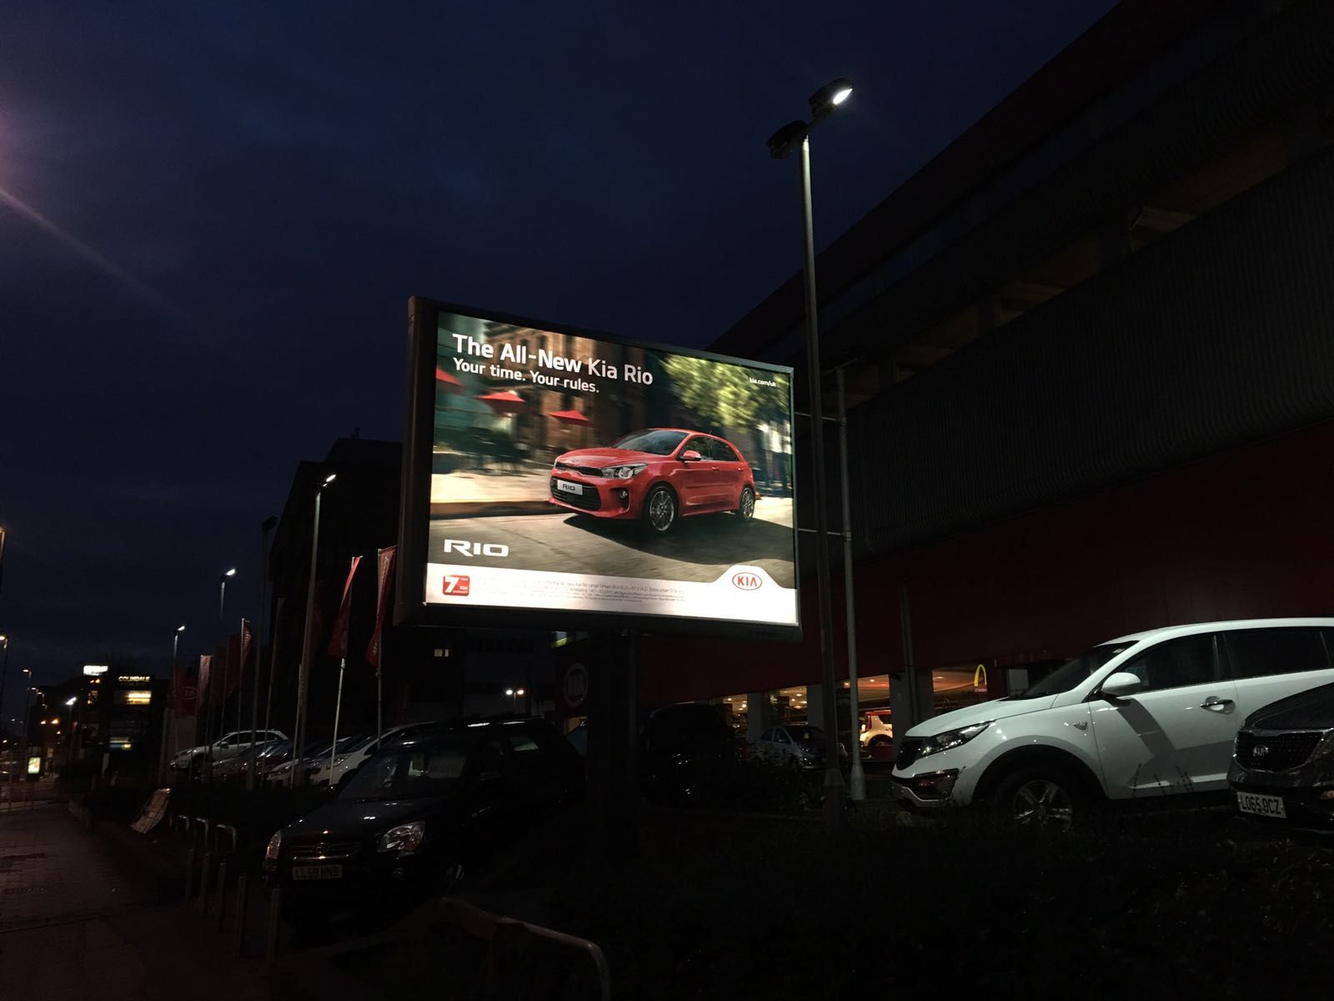
^{Testimonial}
^{Kia Automotive}
‘Having worked in partnership with Trotter UK now for the past four years, we can honestly say that the billboards add value and supplement our marketing strategies really well.
‘We have 40-plus billboards in place across our Kia network and are happy to co-fund this programme in support of our dealerships. We believe they bring a real added presence to the edge of dealers’ forecourts.’
Mel Minetti, Tactical and Dealer Marketing Manager for Kia Motors

Slide 10
What is the cost of The Trotter?
Please contact us for a personalized quote for your specific requirements.
Your point of contact should be displayed on the next slide!

Slide 11

^{info@trotter.co.uk}
^{www.trotter.co.uk}

